Slide 1
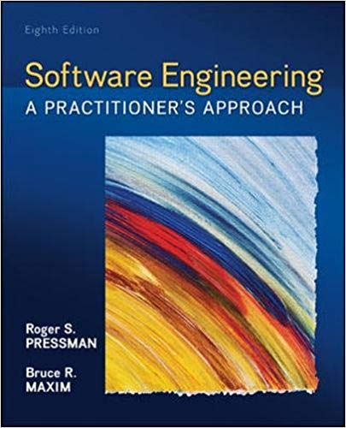
Introduction to Software Engineering
CS46 Software Engineering
Dr. Shilpa chaudhari
Department of Computer Science and Engineering RIT, Bangalore

Slide 2
CS46 Syllabus
 | Software Engineering Course Code: CS46 Credits: 4:0:0:0 | Reference Chapter
Unit I | Software Process: The Changing Nature of Software - WebApps, Mobile Applications, Cloud Computing, Product Line Software; | 1.2
 | Software Process - The Process Framework, Umbrella Activities, Process Adaptation; | 2.2
 | Process Models: Prescriptive Process Models - The Waterfall Model, Incremental Process Models, Evolutionary Process Models, Concurrent Models; Specialized Process Models - Component-Based Development, The Formal Methods Model, Aspect-Oriented Software Development; The Unified Process; | 4.1, 4.2, 4.3
 | Agile Development - What Is Agility? Agility and the Cost of Change, What Is an Agile Process?, Extreme Programming, Other Agile Process Models – Scrum, Dynamic Systems Development Method, Agile Modeling, Agile Unified Process; A Tool Set for the Agile Process; | Chapter 5
 | SPI Process, CMMI; | 37.2, 37.3
 | Case study on current problem statement of software development.
Unit II | Understanding Requirements: Requirements Engineering, Eliciting Requirements, Developing Use Cases, Building the Analysis Model, Negotiating Requirements, Requirements Monitoring, Validating Requirements, Avoiding Common Mistakes. | 8.1, 8.3, 8.4, 8.5 8.6, 8.9
 | Scenario-Based Requirements Modeling: Requirements Analysis, Scenario-Based Modeling, UML Models That Supplement the Use Case. | 9.1, 9.2, 9.3
 | Requirements Modeling for Web and Mobile Apps | 11.5
 | Applying requirement engineering on the same case study of Unit-1.
Notes:
Are you able to understand the difference and applicability of the software process model for the given problem statement?
Are you able understand the various CMMI and its requirements?
Are you able to understand the requirement engineering steps and various documents to be produces as the outcome of this step?
Are you able to apply the analysis concepts to execute the scenario based modeling for the given problem statement?
Are you able to understand the software design principles and concepts?
Are you able to understand and do the software design modeling for the given problem statement?
Are you able to understand various project management concepts such as software maintenance, software quality, review, risk management and project estimation?
Are you able to apply few project management concepts on the for the given problem statement?
Are you abler to understand the software testing strategies and techniques?
Are you able to design the test cases required for the given problem statement?

Slide 3
CS46 Syllabus continued…
Unit III | Design Concepts: The Design Process, Design Concepts, Design Model; | 12.2, 12.3, 12.4
 | Architectural Design: Software Architecture, Architectural Genres, Architectural Styles, Architectural Considerations, Architectural Decisions, Architectural Design; | 13.1, 13.2, 13.3, 13.4, 13.5, 13.6
 | User Interface: The Golden Rules of User Interface Analysis and Design, WebApp and Mobile Interface Design; | 15.1, 15.2,15.5
 | Applying design modeling by taking requirement specification from Unit-2
Unit IV | Quality Concepts: Software Quality, Software Quality Dilemma, Achieving Software Quality | 19.2, 19.3, 19.4
 | Formal Technical Reviews | 20.6
 | Software Project Estimation - Observations on Estimation, The Project Planning Process Software Project Estimation, Decomposition Techniques, Empirical Estimation Models, Estimation for Object-Oriented Projects | 33.1, 33.2, 33.5, 33.6, 33.7, 33.8
 | Project Scheduling –Scheduling. | 34.5
 | Risk Management: Reactive versus Proactive Risk Strategies, Software Risks, Risk Identification, Risk Projection, Risk Refinement, Risk Mitigation, Monitoring, and Management. | 35.1, 35.2, 35.3, 35.4, 35.5, 35.6
 | Computation of relevant metrics for the case study on current problem statement of software development considered in Unit-1.
 | Software Maintenance, Software Supportability, Software Reengineering, Reverse Engineering, Restructuring, Forward Engineering. | 36.2,36.5, 36.6, 36.7, 36.8
Notes:
Unit-3: User Interface: The Golden Rules of User Interface Analysis and Design
Unit-4: Quality Concepts: Software Quality, Software Quality Dilemma, Achieving Software Quality
Software Maintenance- Software Supportability, Software Reengineering, Reverse Engineering, Restructuring
Unit-5:Software Testing Strategies: A Strategic Approach to Software Testing, Strategic Issues, Test Strategies for Conventional Software, Test Strategies for Object-Oriented Software, Test Strategies for WebApps, Test Strategies for MobileApp, Validation Testing, System Testing
Testing Conventional Applications: Software Testing Fundamentals, Internal and External Views of Testing, White-Box Testing, Basis Path Testing, Control Structure Testing, Black-Box Testing

Slide 4
CS46 Syllabus continued…
Unit V | Software Testing Strategies: A Strategic Approach to Software Testing, Strategic Issues, Test Strategies for Conventional Software, Test Strategies for Object-Oriented Software, Test Strategies for WebApps, Test Strategies for MobileApp, Validation Testing, System Testing | 22.1,22.2, 22.3,22.4, 22.5, 22.6, 22.7, 22.8
 | Testing Conventional Applications: Software Testing Fundamentals, Internal and External Views of Testing, White-Box Testing, Basis Path Testing, Control Structure Testing, Black-Box Testing, Model-Based Testing, Testing Documentation and Help Facilities | 23.1, 23.2, 23.3, 23.4, 23.5, 23.6, 23.7, 23.8
 | Testing OOA and OOD Models, Object-Oriented Testing Strategies, Object-Oriented Testing Methods; | 24.3, 24.4
 | Designing test cases as per the requirement specification from Unit-2

Slide 5
Books
Text Book:
Roger S Pressman and Bruce R. Maxim, Software Engineering: A Practitioner's Approach, 8/e, New York: McGraw-Hill, 2015
Reference Books:
Ian Sommerville, Software Engineering, 10th Edition,Pearson, 2016
Emilia Mendes, Nile Mosley: Web Engineering, Springer, 2006
David Gustafson: Software Engineering, Schaum's Outline Series, McGraw Hill, 2002

Slide 6
Course Outcomes (COs)
At the end of the course, the students will be able to:
Explain the various aspects of the software process, considering the important process models and addressing the debate between prescriptive and agile process philosophies.
Understand the analysis and design methods using object-oriented techniques and UML modeling, focusing on web/mobile applications.
Decide all aspects of quality assurance, formal verification techniques, and software maintenance.
Compare the testing strategies required at each phase of software development for a particular case study.
Apply the concepts of software engineering principles on the real-world problems of software development using appropriate tools.

Slide 7
Course Assessment and Evaluation
 | What |  | To Whom | When/ Where (Frequency in the course) | Max Marks | Evidence Collected | Contribution to Course Outcomes
Direct Assessment Methods | CIE | Internal Assessment Test | Student | Twice (Average of both will be computed) | 30 | Blue Books | 1, 2, 3, 4 & 5
 | CIE | Activity based learning for Analysis and Design phases of Life cycle models |  | Review 1 | 10 | Report | 1, 2, 3, 4, 5
 |  |  |  | Review 2 | 10 | Report
 | SEE | Standard Examination |  | End of Course (Answering 5 of 10 questions) | 100 | Answer scripts | 1,2,3,4 & 5
Indirect Assessment Method | End of Course Survey |  | Students | End of the course | - | Questionnaire | 1, 2, 3, 4 & 5 Effectiveness of Delivery of instructions & Assessment Methods

Slide 8
Concept Map
Software Engineering
Requirement Engineering and modeling
Requirement modeling for web and mobile app
include
Architectural design
Analysis model
Design Model
include
Design concepts
presents
User interface design
White box testing
black box testing
Modeling
presents
has
Quality concepts
Project scheduling
testing strategy and tactics
apply
Software Engineering
present
Software project management
include
Risk management
presents
consider
with
s/w maintenance
View of s/w process
s/w process improvement
Testing OOA and OOD models
consider
address
Process models
Prescriptive Vs Agile process

Slide 9
Outline of Session-1
Software Process: The Changing Nature of Software - WebApps, Mobile Applications, Cloud Computing, Product Line Software; Software Process - The Process Framework, Umbrella Activities, Process Adaptation;
Process Models: Prescriptive Process Models - The Waterfall Model, Incremental Process Models, Evolutionary Process Models, Concurrent Models; Specialized Process Models - Component-Based Development, The Formal Methods Model, Aspect-Oriented Software Development; The Unified Process;
Agile Development - What Is Agility? Agility and the Cost of Change, What Is an Agile Process?, Extreme Programming, Other Agile Process Models – Scrum, Dynamic Systems Development Method, Agile Modeling, Agile Unified Process; A Tool Set for the Agile Process;
SPI Process, CMMI; Case study on current problem statement of software development.

Slide 10
Past tragic accidents in major projects

Slide 11
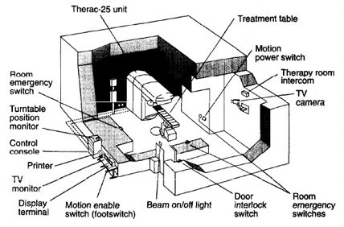
Tragic Accidents I
The Therac-25 Story
Between June 1985 and Jan 1987, a computer-controlled radiation therapy machine, called the Therac-25, massively overdosed six people
software coding error
http://sunnyday.mit.edu/papers/therac.pdf
Notes:
Reusing a shared variables for different purposes and a race condition on that variable led to a situation where lethal doses of radiation were given.
Several deaths resulted from this software error.
The Therac-25 accidents were fairly unique in having software coding errors involved—most computer-related accidents have not involved coding errors but rather errors in the software requirements such as omissions and mishandled environmental conditions and system states. Although using good basic software-engineering practices will not prevent all software errors, it is certainly required as a minimum

Slide 12


Tragic Accidents II
Ariane 5
“On 4 June 1996, the maiden flight of the Ariane 5 launcher ended in a failure…The failure of the Ariane 501 was caused by the complete loss of guidance and attitude information …This loss of information was due to specification and design errors in the software of the inertial reference system.”
Floating number conversion problem
http://www.ima.umn.edu/~arnold/disasters/ariane5rep.html
Notes:
Ariane 5 software reused old code from Ariane 4 that was not respecified and retested in new environment
Code in question performed floating point calculations
Ariane 5 (being more powerful than Ariane 4) caused unanticipated floating-point exception (which would have never occurred on Ariane 4), causing an exception to be thrown which was not caught
Triggered automatic destruction: $500 million loss

Slide 13
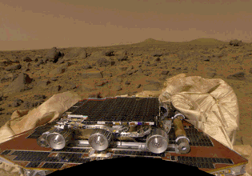
Tragic Accidents III
NASA Mars Pathfinder (1997)
Priority inversion problem led to a system reset and a one-day delay in retransmission of data which wasted valuable mission time.
http://www.cis.ksu.edu/~hatcliff/842/Docs/Course-Overview/pathfinder-robotmag.pdf

Slide 14
Past tragic accidents in major projects observation ………Problem with software

Slide 15
What is Software?
Software is a set of items or objects that form a “configuration” that includes
• programs
• documents
• data ...
Characteristics:
software is engineered
software doesn’t wear out
software is complex
a
Notes:
E.x.1> All packaged software shipped with manual. W/O it, nobody will use it, since the goal of
E.x.2> Google is a good software with massive data.

Slide 16
Software Applications Domains
Dominating Software categories
WebApps (Web applications)
Mobile Applications
Cloud Computing
Product Line Software
system software
application software
engineering/scientific software
embedded software
product-line software
WebApps (Web applications)
AI software
Software—New Categories
Open world computing—pervasive, distributed computing
Ubiquitous computing—wireless networks
Netsourcing—the Web as a computing engine
Open source—”free” source code open to the computing community (a blessing, but also a potential curse!)

Slide 17
Changing nature of software
Web-based systems and applications
Evolved from simple collections of information content to sophisticated systems that present complex functionality and multimedia content
Have unique features and requirements
Mobile applications present new challenges as apps migrate to a wide array of platforms.
Cloud computing will transform the way in which software is delivered and the environment in which it exists.
Product line software offers potential efficiencies in the manner in which software is built

Slide 18
Legacy Software – older programs
Why must it change?
software must be adapted to meet the needs of new computing environments or technology.
software must be enhanced to implement new business requirements.
software must be extended to make it interoperable with other more modern systems or databases.
software must be re-architected to make it viable within a network environment.
Notes:
Be prepared to constant modification. Spend time and energy to prepare them in the early stages.

Slide 19
Why Software Project Fail ?
Lack of s/w mind
Insufficient software
project management
Lack of appropriate SE skills

Slide 20
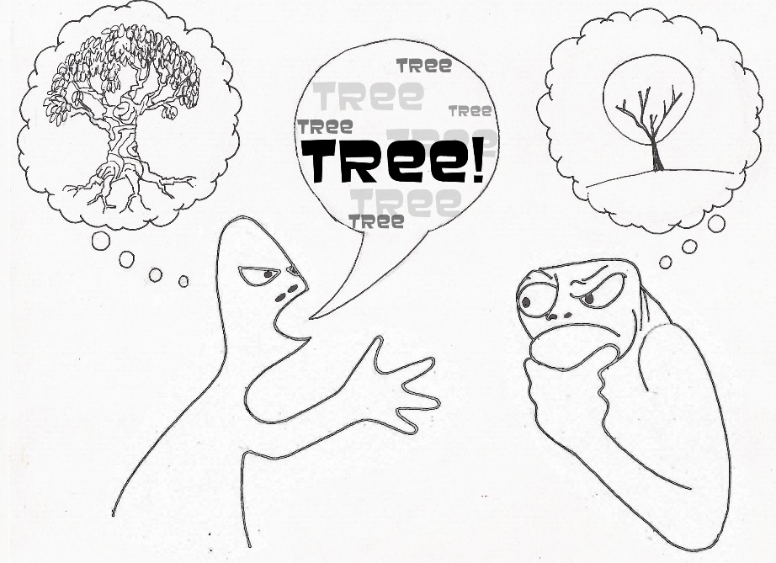
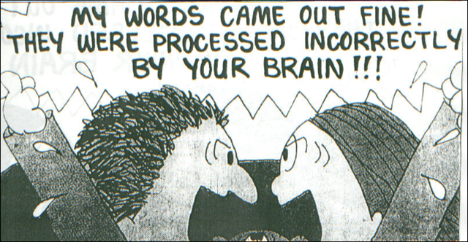
Sources of Errors in S/W Developments
Logic design & Misunderstanding
20%
Functionality &
Misunderstanding
15%
Documentation
& Others 35%
Coding
30%

Slide 21
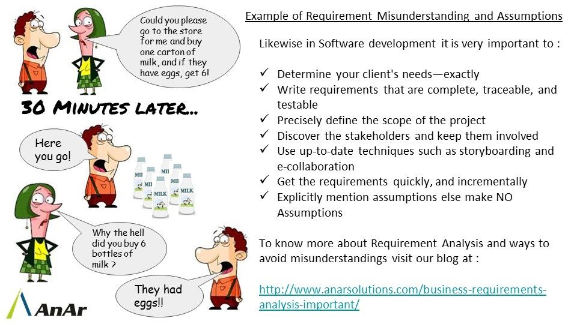

Slide 22
Software Crisis
E 30%
A 2%
B 3%
D 20%
C 45 %
A: worked on delivery
B: worked after some corrections
C: delivered but never successfully used
D: used but either extensively reworked or abandoned
E: paid for, but never delivered
Notes:
The causes of the software crisis
Projects running over-budget
Projects running over-time
Software was very inefficient
Software was of low quality
Software often did not meet requirements
Projects were unmanageable and code difficult to maintain
Software was never delivered

Slide 23
Solutions to software crisis
Management techniques
Team organization
Chief programmer team
Democratic team
Hierarchical team
Better languages and tools
Standards
==> Applying engineering approach
Software Engineering addresses above all aspects

Slide 24
Introduction to Software Engineering

Slide 25
Software Engineering
The IEEE definition:
Software Engineering: (1) The application of a systematic, disciplined, quantifiable approach to the development, operation, and maintenance of software; that is, the application of engineering to software. (2) The study of approaches as in (1).
Forms the basis/context for management of SW project
A set of basic principles
tools
methods
process model
a “quality” focus
Try increasingly more effective approaches
A Layered Technology

Slide 26
Scope of S/W Engineering
Historical Aspects
Economic Aspects
Maintenance Aspects
Specification & Design Aspects
Team Programming Aspects
Notes:
Historical Aspects
1967, A NATO group coined the term " Software Engineering"
1968, NATO conference concluded that software engineering should use the philosophies and paradigms of established engineering disciplines, to solve the problem of software crisis
Economic Aspects
Relationship between computer science and software engineering
cf: chemistry and chemical engineering
Software engineer is intended in only those techniques which make sound economic sense, while computer scientists investigate a variety of ways of producing software, some good and some bad
Team Programming Aspect
Parnas, "Multi-person construction of multiversion software."
Programming : personal activity
S/W engineering : team activity
Programming in early days
The problem is well understood.
Mostly scientific applications.
By a person, who is an expert in that area.
User = programmer = maintainer
User and programmer separation
User: specify the problem(tasks)
Programmer: interpret and translate into code
Team project started in late 1960's
IBM360 Operating system
Software crisis observed
``Software Engineering'' coined

Slide 27
Three Elements of S/W Development
Water-fall process
Incremental process
Evolutionary process
Process
Facilities
Staff
Budget
OOP
Model based testing
Technology
Resources

Slide 28
Software Engineering – Process

Slide 29
Software Engineering – Process
Software Process : a series of steps involving activities, constraints, and resources that produce an intended output of some kind
Process itself - dynamic entity that captures the actions performed
Process specification :
Products, which are the outcomes of a process activity;
Roles, which reflect the responsibilities of the people involved in the process;
Pre- and post-conditions, which are statements that are true before and after a process activity has been enacted or a product produced
Notes:
Software Process - process itself and process description --------------OS Process Image has process and process descriptor

Slide 30
Software Engineering – Process
Process includes many types of activities performed by different people in a software project --- process model
Activities can be considered as many component processes
Activities are related to technical or management issues of software development

Slide 31
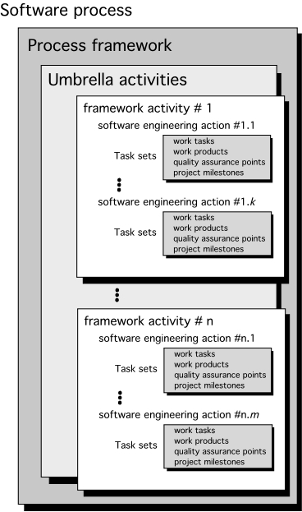
Software Engineering – Process
Framework activities
Communication
Planning
Modeling- Analysis of requirements and Design
Construction- Code generation and Testing
Deployment
Umbrella Activities
Software project management
Formal technical reviews
Software quality assurance
Software configuration management
Work product preparation and production
Reusability management
Measurement
Risk management

Slide 32
Process Adaptation
software engineering process should be agile and adaptable to the problem, to the project, to the team, and to the organizational culture
a process adopted for one project might be significantly different than a process adopted for another project
Differences are
Overall flow of activities, actions, and tasks and the interdependencies among them.
Degree to which
actions and tasks are defined within each framework activity.
work products are identified and required.
detail and rigor with which the process is described.
the customer and other stakeholders are involved with the project.
team organization and roles are prescribed.
Level of autonomy given to the software team.
Manner in which quality assurance activities are applied.
Manner in which project tracking and control activities are applied.

Slide 33
Software Process Model
Process model –
specific roadmap for software engineering work
Defines the flow of all activities, actions and tasks, the degree of iteration, the work products, and the organization of the work that must be done
Varieties of process model
Prescriptive process model - strives for structure and order in software development
Specialized Process Models – characterized for accomplishing a specific software development goal
The Unified Process - framework for UML methods and tools
Personal and Team Process Models - emphasize measurement, planning, and self-direction as key ingredients
Agile Process Models - define maneuverable, adaptive, lean processes

Slide 34
Software Process Model -Prescriptive Models

Slide 35
Prescriptive Models
Prescriptive process models advocate an orderly approach to software engineering
That leads to a few questions …
If prescriptive process models strive for structure and order, are they inappropriate for a software world that thrives on change?
Yet, if we reject traditional process models (and the order they imply) and replace them with something less structured, do we make it impossible to achieve coordination and coherence in software work?
Prescriptive Process models
Waterfall Model - Sometimes called the classic life-cycl
Incremental Process Model
Evolutionary Process Model
Concurrent model

Slide 36
The Waterfall Model (1/2)
It is a systematic, sequential approach to software development that begins with customer specification of requirements and progresses through planning, modelling, construction and deployment.
Bradac[BRA94] found that the linear nature of the waterfall model leads to “blocking states”
Where some members must wait for other members of the team to complete dependent tasks
Especially, at the beginning of the project

Slide 37
The Waterfall Model (2/2)
Still, however, the waterfall model serve as a useful process model where requirements are fixed and work is to proceed to completion in a linear manner
Which problems does the waterfall model have?
Real projects rarely follow the sequential flow
Difficult to accommodating the uncertainty in requirements
A working version of SW will not be available until late in the project

Slide 38
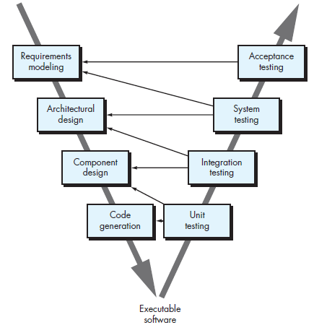
V-Model
Describes the relationship of quality assurance actions to the actions associated with communication, modeling, and early construction activities
provides a way of visualizing how verification and validation actions are applied to earlier engineering work.

Slide 39
The Incremental Model
Combines elements of linear and parallel process flows.
It delivers a series of releases, called increments that provide progressively more functionality for the customer as each is delivered
The first increment is often a core product.
The plan addresses the modification of the core product to better meet the needs of the customer and the delivery of additional feature and functionality.
It focuses on the delivery of an operational product with each increment.
It is useful when staffing is unavailable for a complete implementation.
Increments can be planned to manage technical risks.

Slide 40
The Incremental Model
Can manage
technical risks
Can be implemented
with fewer people

Slide 41
Example using the Incremental Model
Word-processing software
Develop the basic file management, editing, and document production functions in the first increment
More sophisticated editing and document production capabilities in the second increment
Spelling and grammar checking in the third increment

Slide 42
Evolutionary Process Model
Complex systems evolve over a period of time-
Business and product requirements often change as development proceeds.
tight market deadlines make completion of a comprehensive software product impossible, but a limited version must be introduced to meet competitive or business pressure
a set of core product or system requirements is well understood, but the details of product or system extensions have yet to be defined.
Evolutionary models are iterative.
Evolutionary Process Model produce an increasingly more complete version of the software with each iteration.
Specification, development and validation are interleaved.
Evolutionary Process Model
Prototyping
Spiral Model

Slide 43
Evolutionary Models: Prototyping (1/2)
A prototyping paradigm is the best-fit for the following situations
A customer does not identify detailed requirements for SW
SW engineers are not sure of the efficiency of an algorithm, usability of SW, and so on.
The quick design and implementation focuses on a representation of those aspects of the SW that will be visible to the customer
Ideally, the prototype serves as a mechanism for identifying SW requirements
It assists you and stakeholders to better understand what is to built when requirements are fuzzy.
Prototyping paradigm
begins with communication.
planned quickly and modeling occurs
quick design focuses on a representation of those aspects of the software that will be visible to end users.

Slide 44
Evolutionary Models: Prototyping (2/2)
Some problems in prototyping paradigm
SW engineers try to modify the prototype to use as a working version
Once the customer see the working prototype, he/she expects to get working product soon
Overall software quality or long-term maintainability is not considered.
As a Software Engineer make implementation compromises in order to get a prototype working quickly.
Useful
The customer get feel for the actual system and developers get to build something immediately
Key here is all the stakeholders should agree that the prototype is built to serve as a mechanism for defining requirements.
Quick
plan
communication
Modeling
Quick design
Deployment
delivery &
feedback
Construction
of prototype

Slide 45
Evolutionary Models: The Spiral

Slide 46
Evolutionary Models: The Spiral
Characteristics
Originally proposed by Barry Boehm.
It couples the iterative nature of prototyping with the controlled and systematic aspects of water fall model.
Process is represented as a spiral rather than as a sequence of activities with backtracking.
Each loop in the spiral represents a phase in the process.
No fixed phases such as specification or design - loops in the spiral are chosen depending on what is required.
Risks are explicitly assessed and resolved throughout the process.
Uses prototyping as a risk reduction mechanism, but more importantly, enables us to apply the prototyping approach at any stage in the evolution of the product
It is a realistic approach to the development of large-scale systems and software.
The software evolves as the process progresses, the developer and customer better understand and react at each evolutionary level.
It demands considerable risk assessment expertise and realize on this expertise for success.

Slide 47
Evolutionary development
Problems
Do not establish the max. speed of the evolution.
Systems are often poorly structured;
Special skills (e.g. in languages for rapid prototyping) may be required.
Proj. mgmt. and estimation technique do not fit completely
Applicability
For small or medium-size interactive systems;
For parts of large systems (e.g. the user interface);
For short-lifetime systems.

Slide 48
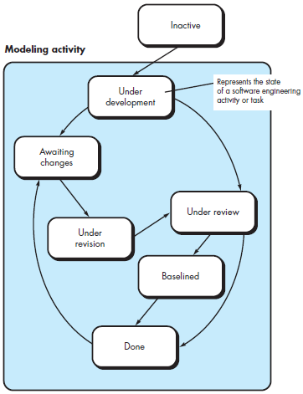
Concurrent Model
The concurrent development model sometimes called Concurrent Engineering.
It allows team to represent iterative and concurrent elements of any of the process models.
All software engineering activities exist concurrently but reside in different states.
Concurrent modeling defines a series of events that will trigger transitions from state to state for each of the activities.
Concurrent modeling is applicable to all types of software development and provide an accurate picture of the current state of a project.

Slide 49
Software Process Model –Specialized Models

Slide 50
Specialized Process Models
Special Process Models take many of the characteristics of the previous models shown.
Special Process Models tend to be used when a narrowly defined Software Engineering Approach is chosen.

Slide 51
Component Based Development
The process to apply when reuse is a development objective
COTS or Commercial Off-The-Shelf components are becoming more available.
Most (not all) COTS components have targeted functionality with good interfaces that enable the component to be integrated.
This approach incorporates many of the aspects of the spiral model.

Slide 52
Formal Methods Development
Model Formal mathematical specification of the software.
Specify, develop and verify by rigorous math notation.
Eliminates ambiguity, incompleteness, and inconsistency.
Used more where safety-critical software is developed, e.g., aircraft avionics, medical devices, etc.

Slide 53
Aspect-Oriented SW Development
AOSD—provides a process and methodological approach for defining, specifying, designing, and constructing aspects (e.g., security, fault-tolerance, the application of business rules)
Nearly all SW has localized features, functions and information content.
User or customer concerns or needs must be included. These can be high-level concerns like security or lower-level such as marketing business rules or systemic such as memory management.
Aspect-Oriented process is new and still developing.

Slide 54
The Unified Process (UP)
A “use-case driven, architecture-centric, iterative and incremental” software process closely aligned with the Unified Modeling Language (UML)

Slide 55
UP Work Products
I
n
c
e
p
t
i
o
n
p
h
a
s
e
V
i
s
i
o
n
d
o
c
u
m
e
n
t
E
l
a
b
o
r
a
t
i
o
n
p
h
a
s
e
I
n
i
t
i
a
l
u
s
e
-
c
a
s
e
m
o
d
e
l
C
o
n
s
t
r
u
c
t
i
o
n
p
h
a
s
e
I
n
i
t
i
a
l
p
r
o
j
e
c
t
g
l
o
s
s
a
r
y
U
s
e
-
c
a
s
e
m
o
d
e
l
I
n
i
t
i
a
l
b
u
s
i
n
e
s
s
c
a
s
e
S
u
p
p
l
e
m
e
n
t
a
r
y
r
e
q
u
i
r
e
m
e
n
t
s
T
r
a
n
s
i
t
i
o
n
p
h
a
s
e
I
n
i
t
i
a
l
r
i
s
k
a
s
s
e
s
s
m
e
n
t
.
i
n
c
l
u
d
i
n
g
n
o
n
-
f
u
n
c
t
i
o
n
a
l
D
e
s
i
g
n
m
o
d
e
l
P
r
o
j
e
c
t
p
l
a
n
,
A
n
a
l
y
s
i
s
m
o
d
e
l
S
o
f
t
w
a
r
e
c
o
m
p
o
n
e
n
t
s
p
h
a
s
e
s
a
n
d
i
t
e
r
a
t
i
o
n
s
.
S
o
f
t
w
a
r
e
a
r
c
h
i
t
e
c
t
u
r
e
I
n
t
e
g
r
a
t
e
d
s
o
f
t
w
a
r
e
D
e
l
i
v
e
r
e
d
s
o
f
t
w
a
r
e
i
n
c
r
e
m
e
n
t
B
u
s
i
n
e
s
s
m
o
d
e
l
,
D
e
s
c
r
i
p
t
i
o
n
.
i
n
c
r
e
m
e
n
t
B
e
t
a
t
e
s
t
r
e
p
o
r
t
s
i
f
n
e
c
e
s
s
a
r
y
.
E
x
e
c
u
t
a
b
l
e
a
r
c
h
i
t
e
c
t
u
r
a
l
T
e
s
t
p
l
a
n
a
n
d
p
r
o
c
e
d
u
r
e
G
e
n
e
r
a
l
u
s
e
r
f
e
e
d
b
a
c
k
O
n
e
o
r
m
o
r
e
p
r
o
t
o
t
y
p
e
s
p
r
o
t
o
t
y
p
e
.
T
e
s
t
c
a
s
e
s
I
n
c
e
p
t
i
o
P
r
e
l
i
m
i
n
a
r
y
d
e
s
i
g
n
m
o
d
e
l
S
u
p
p
o
r
t
d
o
c
u
m
e
n
t
a
t
i
o
n
n
R
e
v
i
s
e
d
r
i
s
k
l
i
s
t
P
r
o
j
e
c
t
p
l
a
n
i
n
c
l
u
d
i
n
g
u
s
e
r
m
a
n
u
a
l
s
i
t
e
r
a
t
i
o
n
p
l
a
n
i
n
s
t
a
l
l
a
t
i
o
n
m
a
n
u
a
l
s
a
d
a
p
t
e
d
w
o
r
k
f
l
o
w
s
d
e
s
c
r
i
p
t
i
o
n
o
f
c
u
r
r
e
n
t
m
i
l
e
s
t
o
n
e
s
i
n
c
r
e
m
e
n
t
t
e
c
h
n
i
c
a
l
w
o
r
k
p
r
o
d
u
c
t
s
P
r
e
l
i
m
i
n
a
r
y
u
s
e
r
m
a
n
u
a
l

Slide 56
Criteria to Select Process Model
Factors | Waterfall | V-Shaped | Evolutionary Prototyping | Spiral | Iterative and Incremental
Unclear User Requirement | Poor | Poor | Good | Excellent | Good
Unfamiliar Technology | Poor | Poor | Excellent | Excellent | Good
Complex System | Good | Good | Excellent | Excellent | Good
Reliable system | Good | Good | Poor | Excellent | Good
Short Time Schedule | Poor | Poor | Good | Poor | Excellent
Strong Project Management | Excellent | Excellent | Excellent | Excellent | Excellent
Cost limitation | Poor | Poor | Poor | Poor | Excellent
Visibility of Stakeholders | Good | Good | Excellent | Excellent | Good
Skills limitation | Good | Good | Poor | Poor | Good
Documentation | Excellent | Excellent | Good | Good | Excellent
Component reusability | Excellent | Excellent | Poor | Poor | Excellent

Slide 57
Software Process Improvement (SPI)

Slide 58
Software Process Improvement
Never stops learning
How to improve software engineering practices?
Address weaknesses in the existing process and work to improve the approach to software work
iterative and continuous approach that lead to a better software process and higher quality software delivery in a more timely manner
Universal five steps: to assess the “maturity” of an organization’s software process and provide a qualitative indication of a maturity level (Maturity Models)
(1) assessment of the current software process
(2) education and training of practitioners and managers
(3) selection and justification of process elements, software engineering methods, and tools
(4) implementation of the SPI plan
(5) evaluation and tuning based on the results of the plan

Slide 59
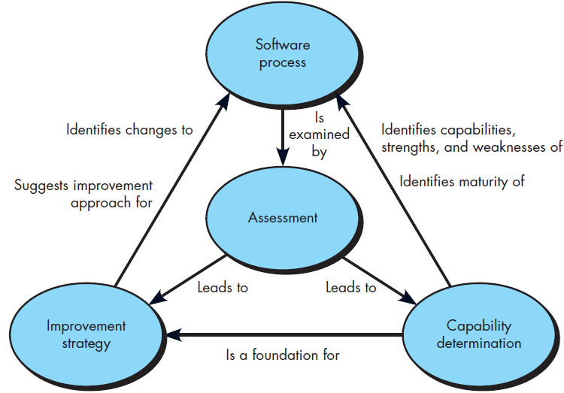
Assessment and Improvement

Slide 60
SPI Process
Software Engineering Institute’s original Capability Maturity Model suggests five levels of maturity ranging from initial (rudimentary software process) to optimized (a process that leads to best practices.
Hard part of SPI - establishing a consensus for initiating SPI and defining an ongoing strategy for implementing it across a software organization
IDEAL road map for SPI | Different road map for SPI
Developed by Software Engineering Institute – defines five distinct SPI activities to guide an organization | five iterative (cyclical) activities are applied in an effort to foster continuous process improvement
Initiating | 1. look in the mirror - Assessment and Gap Analysis
2. Diagnosing | 2. get smarter so it can make intelligent choices - Education and Training
3. Establishing | 3. select the process model (and related technology elements) that best meets its needs - Selection and Justification
4. Acting | 4. instantiate the model into its operating environment and its culture- Installation/Migration
5. Learning | 5. evaluate what has been done - Evaluation

Slide 61
1. Assessment and Gap Analysis
Assessment examines a wide range of actions and tasks that will lead to a high quality process.
Consistency. Are important activities, actions and tasks applied consistently across all software projects and by all software teams?
Sophistication. Are management and technical actions performed with a level of sophistication that implies a thorough understanding of best practice?
Acceptance. Is the software process and software engineering practice widely accepted by management and technical staff?
Commitment. Has management committed the resources required to achieve consistency, sophistication and acceptance?
Gap analysis—The difference between local application and best practice represents a “gap” that offers opportunities for improvement.

Slide 62
2. Education and Training
Three types of education and training should be conducted:
Generic concepts and methods. Directed toward both managers and practitioners, this category stresses both process and practice. The intent is to provide professionals with the intellectual tools they need to apply the software process effectively and to make rational decisions about improvements to the process.
Specific technology and tools. Directed primarily toward practitioners, this category stresses technologies and tools that have been adopted for local use. For example, if UML has been chosen for analysis and design modeling, a training curriculum for software engineering using UML would be established.
Business communication and quality-related topics. Directed toward all stakeholders, this category focuses on “soft” topics that help enable better communication among stakeholders and foster a greater quality focus.

Slide 63
3. Selection and Justification
choose the process model that best fits your organization, its stakeholders, and the software that you build
decide on the set of framework activities that will be applied, the major work products that will be produced and the quality assurance checkpoints that will enable your team to assess progress
develop a work breakdown for each framework activity (e.g., modeling), defining the task set that would be applied for a typical project
Once a choice is made, time and money must be expended to install it within an organization and these resource expenditures should be justified.

Slide 64
4. Installation/Migration
actually software process redesign (SPR) activities. Scacchi states that “SPR is concerned with identification, application, and refinement of new ways to dramatically improve and transform software processes.”
three different process models are considered:
the existing (“as-is”) process,
a transitional (“here-to-there”) process, and
the target (“to be”) process.

Slide 65
5. Evaluation
assesses the degree to which changes have been instantiated and adopted,
the degree to which such changes result in better software quality or other tangible process benefits, and
the overall status of the process and the organizational culture as SPI activities proceed
From a qualitative point of view, past management and practitioner attitudes about the software process can be compared to attitudes polled after installation of process changes.

Slide 66
Risk Management for SPI
manage risk at three key points in the SPI process:
prior to the initiation of the SPI roadmap
during the execution of SPI activities (assessment, education, selection, installation), and
during the evaluation activity that follows the instantiation of some process characteristic.
In general, the following categories can be identified for SPI risk factors:
budget and cost
content and deliverables culture
maintenance of SPI deliverables
mission and goals
organizational management and organizational stability
process stakeholders
schedule for SPI development
SPI development environment and process
SPI project management and SPI staff
Notes:
Using the risk factors and generic attributes as a guide, a risk table (Chapter 35)
can be developed to isolate those risks that warrant further management
attention.

Slide 67
Complete SPI framework
original CMM -developed and upgraded by the Software Engineering Institute throughout the 1990s
Capability Maturity Model Integration (CMMI) - a comprehensive process meta-model
predicated on a set of system and software engineering capabilities that should be present as organizations reach different levels of process capability and maturity
Two different ways for representation of process meta-model
as a “continuous” model - where a capability rating is computed
as a “staged” model- where the model is expressed in terms of capability levels

Slide 68
Continuous CMMI Meta-model
The CMMI defines each process area in terms of “specific goals” and the “specific practices” required to achieve these goals.
each process area is rated according to the following capability levels
Level 0: Incomplete
Level 1: Performed
Level 2: Managed
Level 3: Defined
Level 4: Quantitatively managed
Level 5: Optimized
Specific goals establish the characteristics that must exist if the activities implied by a process area are to be effective.
Specific practices refine a goal into a set of process-related activities.

Slide 69
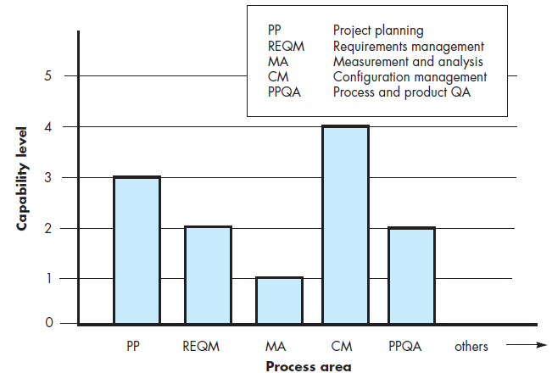
Continuous CMMI Meta-model
Capability levels
Level 0: Incomplete
Level 1: Performed
Level 2: Managed
Level 3: Defined
Level 4: Quantitatively managed
Level 5: Optimized
Notes:
Each process area (e.g., project planning or requirements management) is formally
assessed against specific goals and practices and is rated according to the
following capability levels.
The CMMI defines each process area in terms of “specific goals” and the “specific
practices” required to achieve these goals. Specific goals establish the characteristics that must exist if the activities implied by a process area are to be effective.
Specific practices refine a goal into a set of process-related activities.

Slide 70
Level | Remark on Continuous CMMI Meta-model process area rating level
0:Incomplete | The process area is either not performed or does not achieve all goals and objectives defined by the CMMI for level 1 capability for the process area
1: Performed | All of the specific goals of the process area have been satisfied. - conducted work products
2: Managed | Satisfied all capability level 1 criteria; all work associated with the process area conforms to an organizationally defined policy; all people doing the work have access to adequate resources to get the job done; stakeholders are actively involved in the process area as required; all work tasks and work products are “monitored, controlled, and reviewed; and are evaluated for adherence to the process description”
3: Defined | All capability level 2 criteria have been achieved. Process is “tailored from the organization’s set of standard processes according to the organization’s tailoring guidelines, and contributes work products, measures, and other process-improvement information to the organizational process assets”
4: Quantitatively managed | All capability level 3 criteria have been achieved. Process area is controlled and improved using measurement and quantitative assessment
5: Optimized | All capability level 4 criteria have been achieved. Process area is adapted and optimized using quantitative (statistical) means to meet changing customer needs and to continually improve the efficiency of the process area under consideration

Slide 71
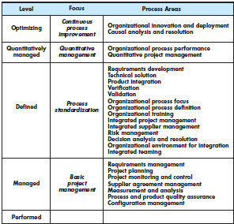
Staged CMMI model
defines five maturity levels, rather than five capability levels
To achieve a maturity level, the specific goals and practices associated with a set of process areas must be achieved.

Slide 72
Agile Development
Notes:
Agile: able to move quickly and easily.
relating to or denoting a method of project management, used especially for software development, that is characterized by the division of tasks into short phases of work and frequent reassessment and adaptation of plans.

Slide 73
The Manifesto for Agile Software Development
“We are uncovering better ways of developing software by doing it and helping others do it. Through this work we have come to value:
Individuals and interactions v.s. processes and tools
Working software v.s. comprehensive documentation
Customer collaboration v.s. contract negotiation
Responding to change v.s. over following a plan
That is, while there is value in the items on the right, we value the items on the left more.”
Kent Beck et al
Notes:
prescriptive process models have a major failing: they forget the frailties (weakness) of the people who build computer software.

Slide 74
What is “Agility”?
Effective (rapid and adaptive) response to change
Effective communication among all stakeholders
Drawing the customer onto the team
Organizing a team so that it is in control of the work performed
Yielding …
Rapid, incremental delivery of software

Slide 75
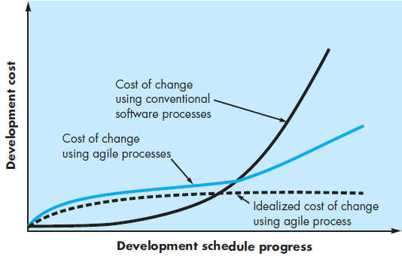
Agility and the Cost Of Change
Notes:
cost of change increases nonlinearly as a project progresses
well-designed agile process “flattens” the cost of change curve
Conventional wisdom is that the cost of change increases nonlinearly
as a project progresses. It is relatively easy to accommodate a change
when a team is gathering requirements early in a project. If there are
any changes, the costs of doing this work are minimal. But if the middle
of validation testing, a stakeholder is requesting a major functional
change. Then the change requires a modification to the architectural
design, construction of new components, changes to other existing
components, new testing and so on. Costs escalate quickly. !
A well-designed agile process may “flatten” the cost of change curve
by coupling incremental delivery with agile practices such as
continuous unit testing and pair programming. Thus team can
accommodate changes late

Slide 76
An Agile Process
Is driven by customer descriptions of what is required (scenarios)
Recognizes that plans are short-lived
Develops software iteratively with a heavy emphasis on construction activities
Delivers multiple ‘software increments’
Adapts as changes occur
Notes:
Agile Process An Agile process -  Is driven by customer descriptions of what is required (scenarios)  Recognizes that plans are short-lived  Develops software iteratively with a heavy emphasis on construction activities  Delivers multiple ‘software increments’  Adapts as changes occur

Slide 77
12 Principles of Agile Process
To satisfy the customer through early and continuous delivery of valuable SW
Welcome changing requirements, even late in development
Deliver working SW frequently (from a couple of weeks to a couple of months)
Business people and developers must work together daily
Build projects around motivated individuals
The most effetive method of communication is face-to-face conversation
Working SW is the primary measure of progress
Agile processes promote sustainable development
Continuous attention to technical excellence and good design
Keep it simple (KIS)
The best architectures, requirements, and designs emerge from self-organinzing teams
At regular intervals, the team reflects on how to become more effective, then tunes and adjusts its behavior

Slide 78
Human Factors
the process molds to the needs of the people and team, not the other way around
key traits must exist among the people on an agile team and the team itself:
Competence.
Common focus.
Collaboration.
Decision-making ability.
Fuzzy problem-solving ability.
Mutual trust and respect.
Self-organization.

Slide 79
The Politics of Agile Development
There is considerable debate (sometimes strident) about the benefits and applicability of agile software development as opposed to more conventional software engineering processes.
Like all software technology arguments, this methodology debate risks degenerating into a religious war. If warfare breaks out, rational thought disappears and beliefs rather than facts guide decision making.
No one is against agility. The real question is: What is the best way to achieve it?
There are no absolute answers to either of these questions. Even within the agile school itself, there are many proposed process models, each with a subtly different approach to the agility problem.

Slide 80
Extreme Programming
The most widely used agile process, originally proposed by Kent Beck
Extreme Programming –
is one of the most important software development framework of Agile models.
Is used to improve software quality and responsive to customer requirements.
model recommends taking the best practices that have worked well in the past in program development projects to extreme levels.

Slide 81
Extreme Programming (XP)
XP Planning
Begins with the creation of “user stories” that describe required features and functionality for SW
Agile team assesses each story and assigns a cost (in weeks)
Stories are grouped to for a deliverable increment
A commitment is made on delivery date
After the first increment “project velocity” (# of user stories implemented during the first release) is used to help define subsequent delivery dates for other increments

Slide 82
Extreme Programming (XP)
XP Design- Follows the KIS principle
Encourage the use of CRC (class-responsibility-collaborator) cards
For difficult design problems, suggests the creation of a spike solution (a design prototype)
A spike solution is a very simple program to explore potential solutions.
Encourages “refactoring”—an iterative refinement of the internal program design
XP Coding
Recommends the construction of a unit test for a store before coding commences
Test oriented implementation
Encourages “pair programming”
XP Testing- All unit tests are executed daily
“Acceptance tests” are defined by the customer and executed to assess customer visible functionality

Slide 83
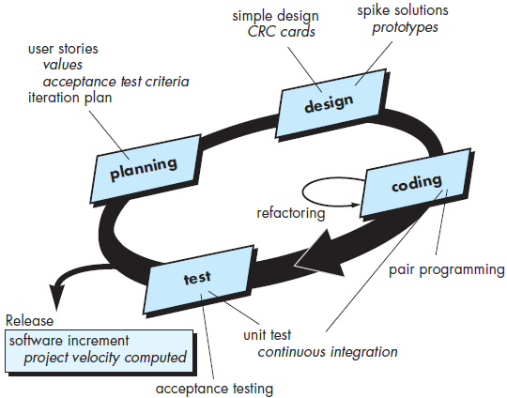
Extreme Programming (XP)

Slide 84
Industrial Extreme Programming (IXP)
incorporates six new practices for significant projects within a large organization
Readiness assessment
Project community
Project chartering
Test-driven management
Retrospectives
Continuous learning
modifies a number of existing XP practices and redefines certain roles and responsibilities to make them more amenable to significant projects for large organizations
Notes:
incorporates six new practices that are designed to help ensure that an XP project works successfully for significant projects within a large organization

Slide 85
Other Agile Process Models
Many other agile process models have been proposed and are in use across the industry.
Among the most common are:
Adaptive Software Development (ASD)
Scrum
Dynamic Systems Development Method (DSDM)
Crystal
Feature Drive Development (FDD)
Lean Software Development (LSD)
Agile Modeling (AM)
Agile Unified Process (AUP)

Slide 86
Scrum
Originally proposed by Schwaber and Beedle
Scrum—distinguishing features
Testing and documentation are on-going as the product is constructed
Work occurs in “sprints” and is derived from a “backlog” of existing requirements
Backlog: a prioritized list of project requiremetns or features
Sprint: work tasks within a process pattern
Daily meetings are very short and sometimes conducted without chairs
Demos are delivered to the customer within the time-box allocated

Slide 87
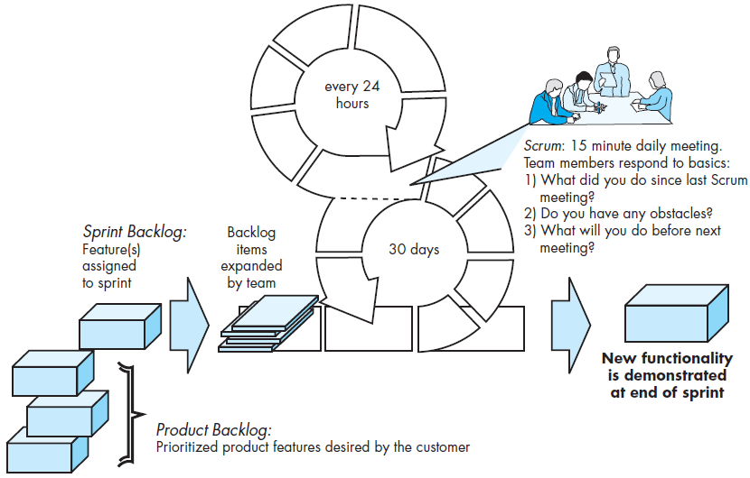
Scrum Process Flow

Slide 88
Dynamic Systems Development Method (DSDM)
Promoted by the DSDM Consortium (www.dsdm.org)
DSDM—distinguishing features
Similar in most respects to XP and/or ASD
Nine guiding principles
Active user involvement is imperative.
DSDM teams must be empowered to make decisions.
The focus is on frequent delivery of products.
Fitness for business purpose is the essential criterion for acceptance of deliverables.
Iterative and incremental development is necessary to converge on an accurate business solution.
All changes during development are reversible.
Requirements are baselined at a high level
Testing is integrated throughout the life-cycle.

Slide 89
Agile Modeling
Originally proposed by Scott Ambler
practice-based methodology for effective modeling and documentation of software-based systems
adopts all of the values that are consistent with the agile manifesto
Suggests a set of agile modeling principles for building large, business critical systems
Model with a purpose
Use multiple models
Travel light - keep only those models that will provide long-term value and jettison the rest
Content is more important than representation
Know the models and the tools you use to create them
Adapt locally

Slide 90
Agile Unified Process
adopts a “serial in the large” and “iterative in the small”
has historical and technical connections to the Unified Modeling Language
Activities of Each AUP iteration
Modeling
Implementation
Testing
Deployment
Configuration and project management
Environment management

Slide 91
A Tool Set for Agile Process
Social- starting even at the hiring stage
Technological - helping distributed teams simulate being physically present
Physical - allowing people to manipulate them in workshops
Collaborative and communication “tools”
Active communication is achieved via the team dynamics
passive communication is achieved by “information radiators”
Project management tools - deemphasize the Gantt chart and uses earned value charts or “graphs of tests created versus passed

Slide 92
Tools – support agile approach
OnTime, developed by Axosoft ( www.axosoft.com ), provides agile process management support for various technical activities within the process.
Ideogramic UML, developed by Ideogramic ( http://ideogramic-ml.software.informer.com/ ) is aUML tool set specifically developed for use within an agile process.
Together Tool Set, distributed by Borland ( www. borland.com ), provides a tools suite that supports many technical activities within XP and other agile processes.

Slide 93
Factors | Waterfall | V-Shaped | Evolutionary Prototyping | Spiral | Iterative and Incremental | Agile
Unclear User Requirement | Poor | Poor | Good | Excellent | Good | Excellent
Unfamiliar Technology | Poor | Poor | Excellent | Excellent | Good | Poor
Complex System | Good | Good | Excellent | Excellent | Good | Poor
Reliable system | Good | Good | Poor | Excellent | Good | Good
Short Time Schedule | Poor | Poor | Good | Poor | Excellent | Excellent
Strong Project Management | Excellent | Excellent | Excellent | Excellent | Excellent | Excellent
Cost limitation | Poor | Poor | Poor | Poor | Excellent | Excellent
Visibility of Stakeholders | Good | Good | Excellent | Excellent | Good | Excellent
Skills limitation | Good | Good | Poor | Poor | Good | Poor
Documentation | Excellent | Excellent | Good | Good | Excellent | Poor
Component reusability | Excellent | Excellent | Poor | Poor | Excellent | Poor

Slide 94
Summary
Software engineering is an engineering discipline that is concerned with all aspects of software production.
The high-level activities of specification, development, validation and evolution are part of all software processes.

Slide 95
Small size problem: simple address book
The first task that must be performed in any project is clearly understanding the requirements.
view the Use Cases and Further Analysis

Slide 96
Simple Address Book - Requirements Statement
The software to be designed is a program that can be used to maintain an address book. An address book holds a collection of entries, each recording a person's first and last names, address, city, state, zip, and phone number.
It must be possible to add a new person to an address book, to edit existing information about a person (except the person's name), and to delete a person. It must be possible to sort the entries in the address book alphabetically by last name (with ties broken by first name if necessary), or by ZIP code (with ties broken by name if necessary). It must be possible to print out all the entries in the address book in "mailing label" format.
It must be possible to create a new address book, to open a disk file containing an existing address book to close an address book, and to save an address book to a disk file, using standard New, Open, Close, Save and Save As ... File menu options. The program's File menu will also have a Quit option to allow closing all open address books and terminating the program.

Slide 97
Simple Address Book - Requirements Statement
The initial requirements call for the program to only be able to work with a single address book at a time; therefore, if the user chooses the New or Open menu option, any current address book will be closed before creating/opening a new one. A later extension might allow for multiple address books to be open, each with its own window which can be closed separately, with closing the last open window resulting in terminating the program. In this case, New and Open will result in creating a new window, without affecting the current window.
The program will keep track of whether any changes have been made to an address book since it was last saved, and will offer the user the opportunity to save changes when an address book is closed either explicitly or as a result of choosing to create/open another or to quit the program.
The program will keep track of the file that the current address book was read from or most recently saved to, will display the file's name as the title of the main window, and will use that file when executing the Save option. When a New address book is initially created, its window will be titled "Untitled", and a Save operation will be converted to Save As ... - i.e. the user will be required to specify a file.

